Slide 1

CREATIVE AND INNOVATIVE PROJECT (CS6611)
TEAM NO: 14
Aadithya Naresh - 2018103501
Sibi Akash -2018103594
Vivek Ramkumar - 2018103082

Slide 2
CARDIAC ARRHYTHMIA DETECTION AND CLASSIFICATION USING ECG SIGNALS

Slide 3
CONTENTS:
ABSTRACT
INTRODUCTION
PROBLEM STATEMENT
ISSUES IDENTIFIED
LITERATURE SURVEY
BLOCK DIAGRAM
MODULES WITH INPUT/OUTPUT AND PSEUDOCODE
CONTRIBUTION/ INNOVATION
SCREENSHOT OF EACH MODULE / INTERMEDIATE RESULTS
CONCLUSION AND FUTURE DIRECTION
REFERENCES

Slide 4
INTRODUCTION
Cardiac arrhythmia is a group of conditions in which the heartbeat is irregular, too fast, or too slow. Arrhythmias occur due to problems with electrical conduction system of the heart.
The proposed system is going to discuss and explain the prediction of abnormal beats in a patient and represent it using an ECG graph.
We will train one neural network and use various other machine learning algorithms based on the abnormal beats to determine which of the proposed models will provide us with better performance. The performance can be measured with different factors.
Undiagnosed cardiac arrhythmias often evolve undetected [1], reducing the effectiveness of treatment in advanced stages. In addition, tachyarrhythmia events are associated with sudden death [2], occurring less than an hour after symptoms onset

Slide 5
ABSTRACT:
A large part of the biomedical research spectrum is dedicated to develop electrocardiogram (ECG) signal processing techniques to contribute to early diagnosis.
Whilst most methods are offline, we intend to propose a system which can be used for on-line detection of the abnormality and the arrhythmia.
Classification is conducted by means of a Neural Network and various other machine learning algorithms
The algorithm is tested with 17 ECG records obtained from the MIT-BIH dataset from the PhysioNet repository.

Slide 6
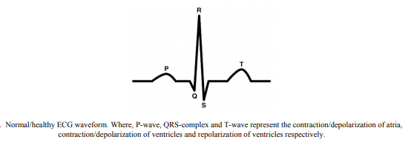

Slide 7
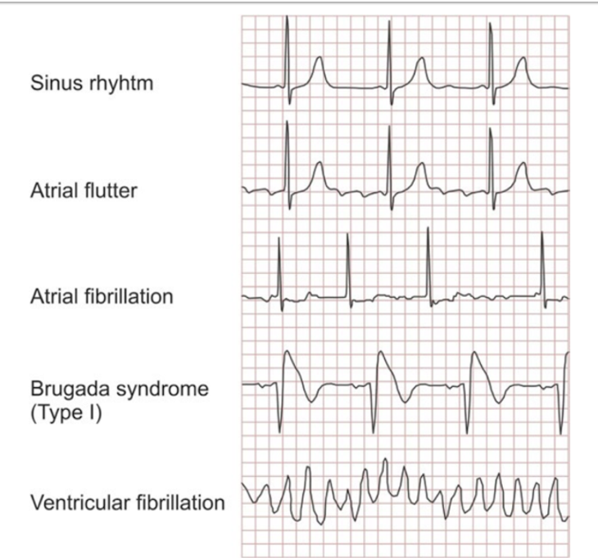
TYPES OF CARDIAC ARRHYTHMIA

Slide 8
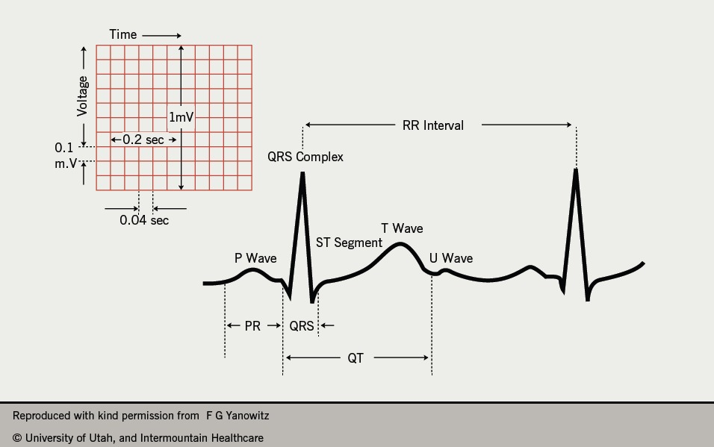
Normal ECG wave

Slide 9

PROBLEM STATEMENT
The task we have on hand is to do an on-line cardiac arrhythmia detection.
However, many ECG analysis results reported are confined to traditional, off-line, PC-based operation.
In this work, we are concerned with two problems.
First, we want to classify a record into binary classes (normal or abnormal).
Second, we want to classify a record into multiple classes, depending on the specific case of arrhythmia present (multi-class classification)

Slide 10
LITERATURE SURVEY
S.no. | Authors | Publication | Year | Methodology | Test conditions
1 | Albert Haque | Cardiac Dysrhythmia Detection with GPU-Accelerated Neural Network | 2015 | The approaches can be grouped into two categories: (i) statistical learning based on explicit feature extraction and (ii) recognizing patterns from the raw time series data. | The authors use 17 MIT-BIH arrhythmia database records.

Slide 11
S.NO. | Authors | Publication | Year | Methodology | Test conditions
2. | Pranav Rajpurkar,Awni Y. Hannun,Masoumeh Haghpanahi,Codie Bourn,Andrew Y. Ng [8] | Cardiologist-Level Arrhythmia Detection with Convolutional Neural Network | 2017 | They use a convolutional neural network for the sequence-to-sequence learning task. The network takes as input a time-series of raw ECG signal, and outputs a sequence of label predictions. The 30 second long ECG signal is sampled at 200Hz, and the model outputs a new prediction once every second. We arrive at an architecture which is 33 layers of convolution followed by a fully connected layer and a softmax. | The authors use a self constructed research based arrhythmia database.

Slide 12
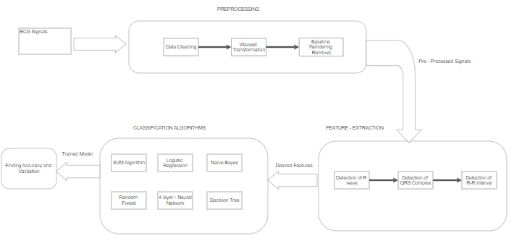

B L O C K D I A G R A M

Slide 13
MODULES WITH INPUT AND OUTPUT
WITH MODULE WISE INPUT OUTPUT DIAGRAM

Slide 14
MODULE 1: PREPROCESSING
Input: Ecg signal dataset
Output: Baseline wander frequency normalized Ecg signal dataset
Tools used: Matlab
MIT-BIH Arrhythmia dataset is processed using Discrete Wave Transformation (DWT) to remove the baseline wander frequency. First, the baseline of the signal is subtracted. Additionally, some noise removal can be done. Two median filters are applied for this purpose, of 200-ms and 600-ms. These values depend on the frequency sampling of the signal. The signal resulting from the second filter operation contains the baseline wanderings and can be subtracted from the original signal. Now, we have baseline wander frequency normalized ecg signals.

Slide 15
PSEUDO CODE:
Fs = input('Enter sampling rate:');
ecg = load("C:\Users\aadit\Downloads\102m.mat");
ecgsig = (ecg.val)./200;
t = 1:length(ecgsig);
tx = t./Fs;
wt = modwt(ecgsig,4,'sym4');
wtrec = zeros(size(wt));
wtrec(3:4,:) = wt(3:4,:);
y = imodwt(wtrec,'sym4');
y = abs(y).^2;
subplot(211);
plot(tx,y);
plot(tm,ecgsig)
hold on
plot(tm(ann),ecgsig(ann),'ro')
xlabel('Seconds')
ylabel('Amplitude')
title('Subject - MIT-BIH 200')

Slide 16
MODULE 2 : FEATURE EXTRACTION – DETECTION OF R WAVES
Input: Normalized Ecg signal dataset
Output: R-R interval for each beat (in s), Position of R referenced to beginning of the segment.
Tools used: Matlab
The R peak can be located from the pair maximum-minimum zero-crossings.R-R interval is the time interval between successive R-peaks in a heartbeat. This is an important feature in classifying an ecg signal.

Slide 17
PSEUDO CODE:
[signal,Fs,tm]=rdsamp('mitdb/109',1,10000) ;
[ann,type] = rdann('mitdb/109', 'atr',1,10000,[],'L') ;
disp(strcat('ANN=',num2str(ann/360)));
figure
disp(num2str(length(signal)));
disp(num2str(length(tm)));
plot(tm,signal)
hold on
plot(tm(ann),signal(ann),'ro')
xlabel('Seconds')
ylabel('Amplitude')
title('Subject - MIT-BIH 100')
wt = modwt(signal((19/360):(3587/360)),5);

Slide 18
PSEUDO CODE:
wtrec = zeros(size(wt));
wtrec(4:5,:) = wt(4:5,:);
y = imodwt(wtrec,'sym4');
y = abs(y).^2;
[qrspeaks,locs] = findpeaks(y,tm,'MinPeakHeight',0.30,...
'MinPeakDistance',0.150);
[rrlocs] = zeros(34,1);
for f=2:length(locs)
rrlocs(f) = locs(f) - locs(f-1);
end
%disp(strcat('R location = ',num2str(locs)));
%disp(strcat('RR interval = ',num2str(rrlocs)));
figure
plot(tm,y)
hold on
plot(locs,qrspeaks,'ro')
xlabel('Seconds')
title('R Peaks Localized by Wavelet Transform with Automatic Annotations')
wtrec = zeros(size(wt));
wtrec(4:5,:) = wt(4:5,:);
y = imodwt(wtrec,'sym4');
y = abs(y).^2;
[qrspeaks,locs] = findpeaks(y,tm,'MinPeakHeight',0.30,...
'MinPeakDistance',0.150);
[rrlocs] = zeros(34,1);
for f=2:length(locs)
rrlocs(f) = locs(f) - locs(f-1);
end
%disp(strcat('R location = ',num2str(locs)));
%disp(strcat('RR interval = ',num2str(rrlocs)));
figure
plot(tm,y)
hold on
plot(locs,qrspeaks,'ro')
xlabel('Seconds')
title('R Peaks Localized by Wavelet Transform with Automatic Annotations')

Slide 19
MODULE 3 : FEATURE EXTRACTION – DETECTION OF QRS COMPLEX
Input: Normalized Ecg signal dataset
Output: QRS duration for each beat (in s)
Tools used: Matlab
The beginning of a QRS complex is the first local maximum before an R peak and the end is first local minimum after an R-peak.In the case where there is not an S wave component detectable,the search is extended until the extreme on R peak is reached.

Slide 20
PSEUDO CODE:
[signal,Fs,tm]=rdsamp('118',1,10000) ;
[ann,type] = rdann('118', 'atr',1,10000 ) ;
analysis = RunBioSigKit(signal,Fs,0);
analysis.MTEO_qrstAlg();
tR = analysis.Results.R/360;
locs = analysis.Results.P;
tP = (locs)/360;
locsQ = analysis.Results.Q;
tQ = (locsQ)/360;
locsS = analysis.Results.S;
tS = (locsS)/360;
[QRSlocs] = zeros(34,1);
for f=2:length(locs)
QRSlocs(f) = tS(f) - tQ(f);
end
disp(strcat('QRS intervals = ',num2str(QRSlocs)));

Slide 21
MODULE 4: FEATURE EXTRACTION – DETECTION OF PR INTERVALS
Input: Normalized Ecg signal dataset
Output: PR interval for each beat (in s), Number of P waves for each beat.
Tools used: Matlab
Identify the P waves available from the particular ECG signal using Multilevel Teager Energy Operator Algorithm. This algorithm employs Multilevel Teager Energy Operator (MTEO) in order to locate the QRS complexes and PR intervals. Once the QRS complex has been identified, in a similar manner to that presented the procedure uses a search window defined by the end of a QRS complex and the beginning of the next QRS complex.

Slide 22
PSEUDO CODE:
[[signal,Fs,tm]=rdsamp('mitdb/105',1,20000);
%[ann,type] = rdann('mitdb/118', 'atr',1,10000,[],'L');
%disp(strcat('ANN=',num2str(ann(1)/360)));
x = 13;
y = 3978;
analysis = RunBioSigKit(signal,Fs,0);
analysis.MTEO_qrstAlg();
timelimit = (y-x)/360;
tR = analysis.Results.R/360;
disp(strcat('Heart rate=',num2str(length(tR)*60/timelimit)));
locs = analysis.Results.P;
tP = (locs)/360;
locsQ = analysis.Results.Q;
tQ = (locsQ)/360;
locsS = analysis.Results.S;
tS = (locsS)/360;
[PRlocs] = zeros(length(tP),1);
for f=1:length(tP)
PRlocs(f) = tR(f) - tP(f);
end
%writematrix(PRlocs,'M.csv')
disp(strcat('R locs = ',num2str(tR)));
disp(strcat('R locs = ',num2str(tP)));
disp(strcat('PR intervals = ',num2str(PRlocs)));

Slide 23
MODULE 5: CLASSIFIER MODELS:
Input: Extracted features annotated with arrhythmia class for each data segment.
Output: Predicted classes for test data.
Tools used: Python, Jupyter Notebook.
Once individual waves have been located, a set of features for each heartbeat is obtained, and the results for the data segment are stored in an csv file. We use classifier models such as Neural Networks, Svm,Logistic regression and Decision Tree.Using these models we predict arrhythmia for the split test data and also classify what kind of Arrhythmia if present.

Slide 24
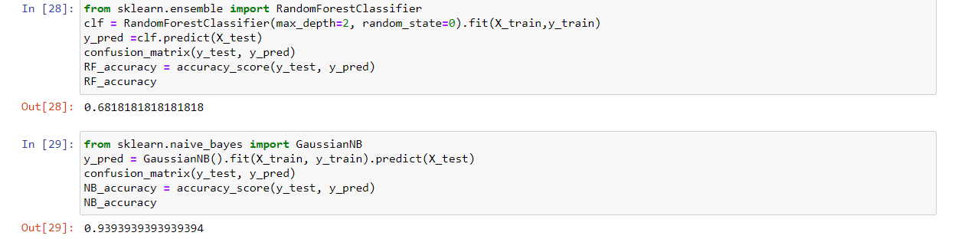
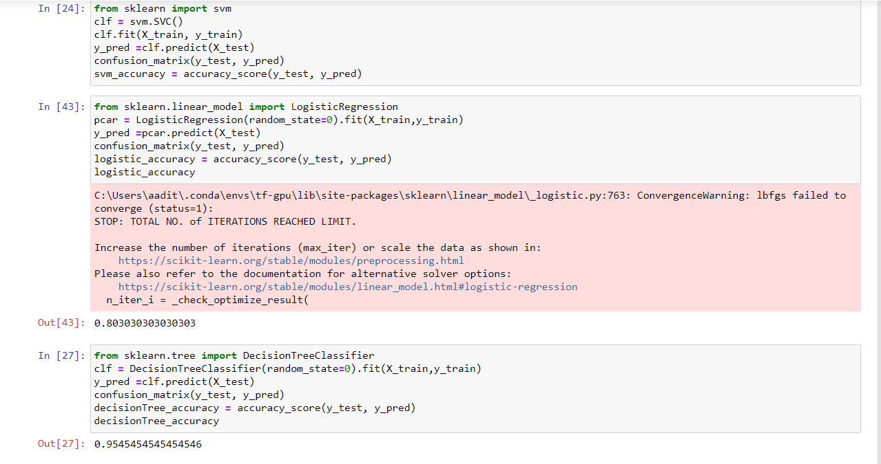

Slide 25
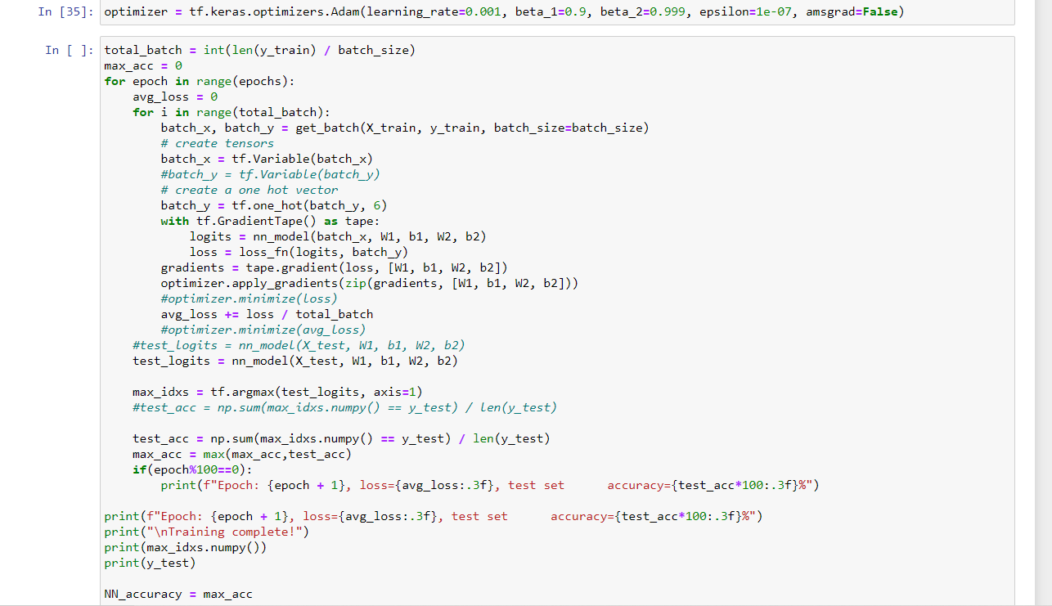
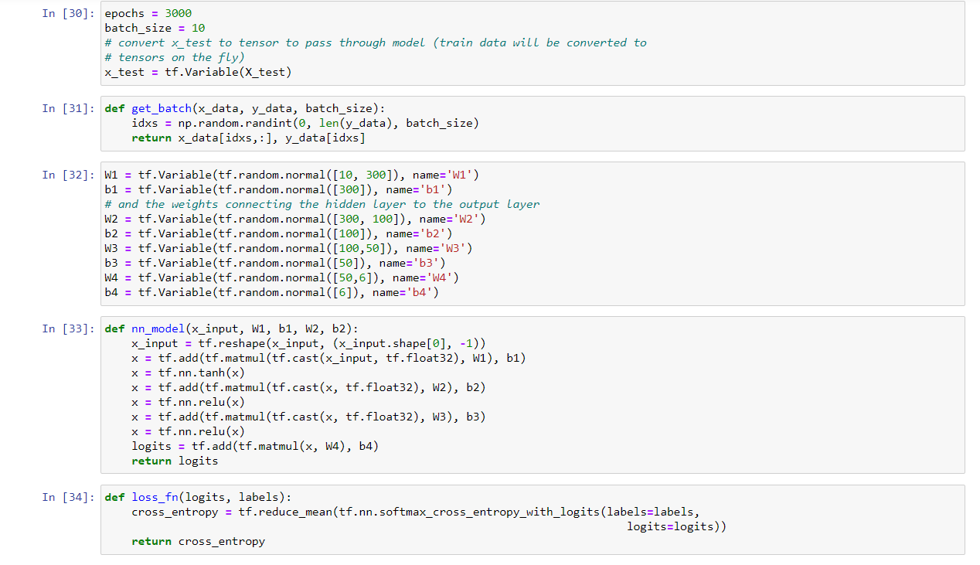

Slide 26
MODULE 6 : ACCURACY AND VALIDATION
Input: Predicted and actual arrhythmia classes.
Output: Accuracy of the the classifier model
Tools used: Python, Jupyter Notebook.
Classified ecg signals from the classifier models are validated and then accuracy of the model is determined.The accuracy of these models are compared and the best model is determined.

Slide 27
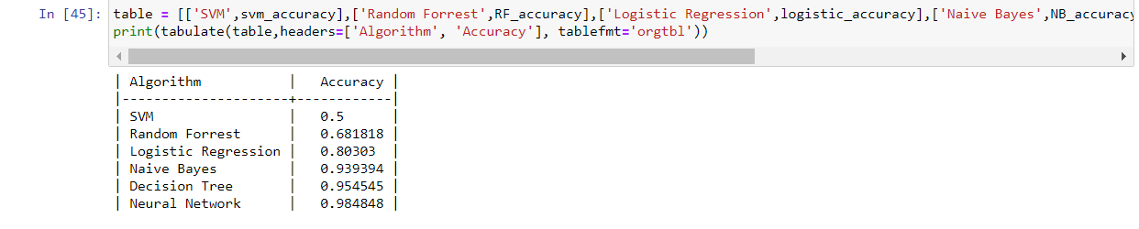

Slide 28
SCREENSHOT OF EACH MODULES / INTERMEDIATE RESULTS
Code and the corresponding outputs

Slide 29
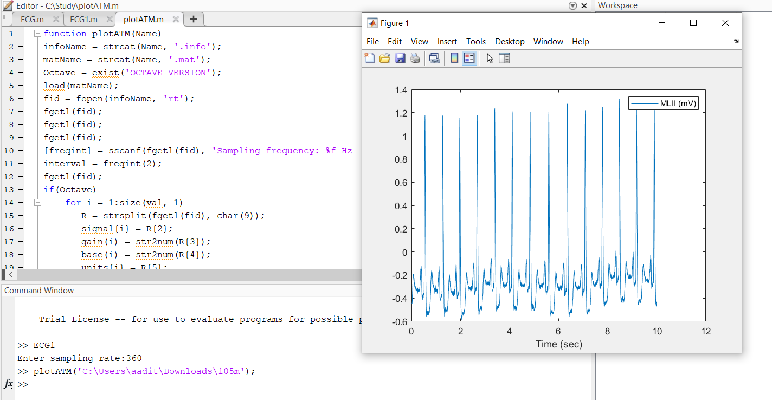
MODULE 1: PRE PROCESSING THE DATASET
Code screenshots:
Original ecg signals:

Slide 30
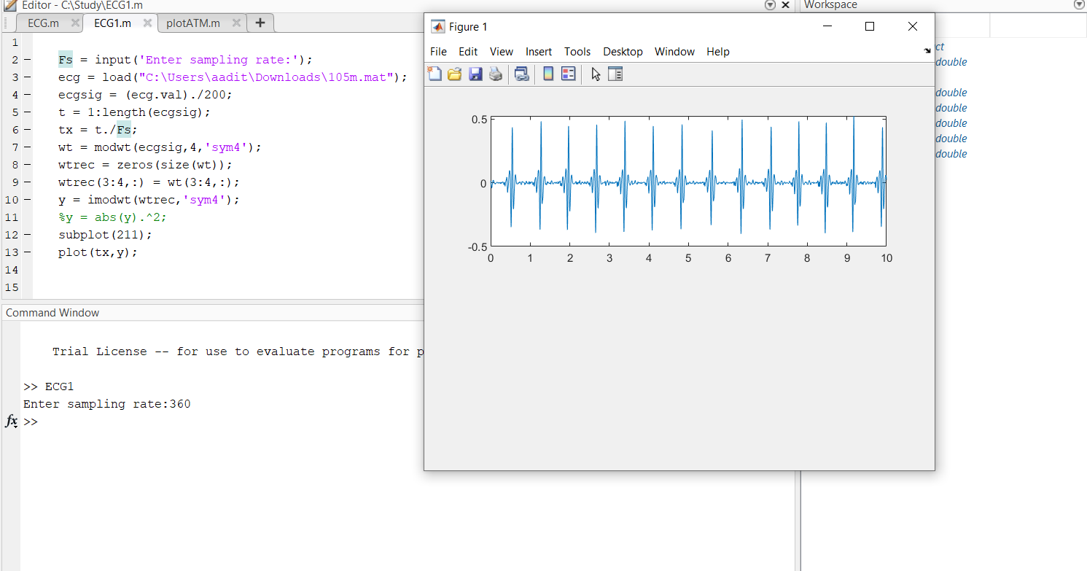
MODULE 1: PRE PROCESSING THE DATASET
Normalised ECG Signals:

Slide 31
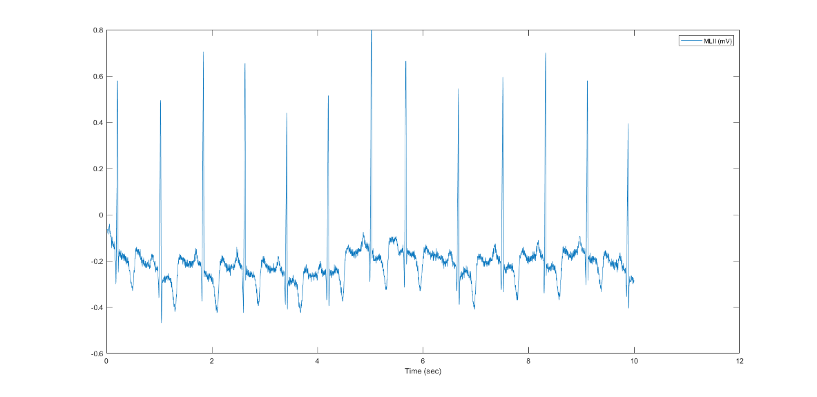
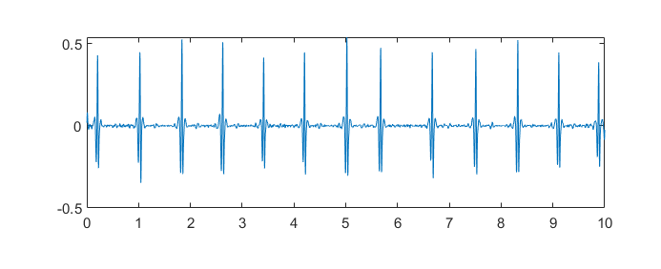
MODULE 1: PRE PROCESSING THE DATASET
Output screenshots:
Record 1:
With baseline wandering:
Without Baseline wandering:

Slide 32
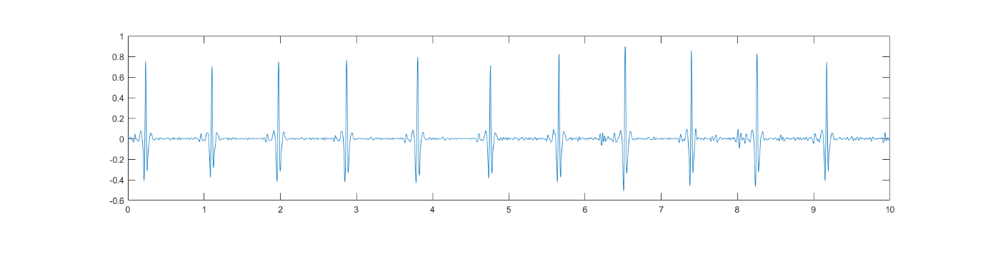
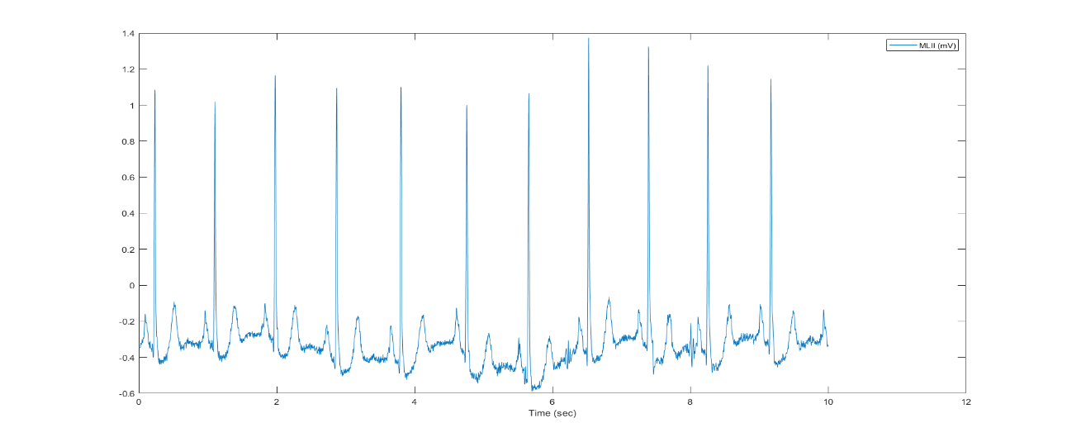
MODULE 1: PRE PROCESSING THE DATASET
Output screenshots:
Record 2 :
With baseline wandering:
Without Baseline wandering:

Slide 33
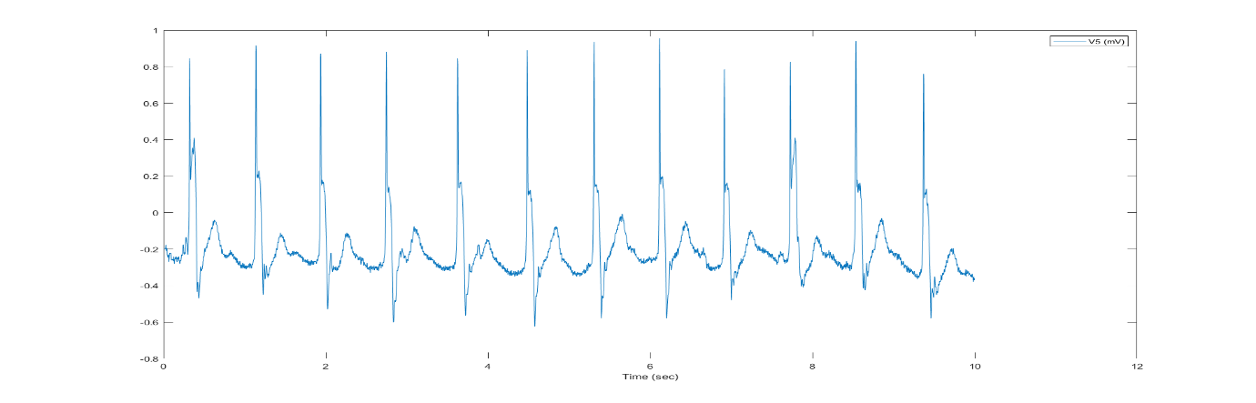
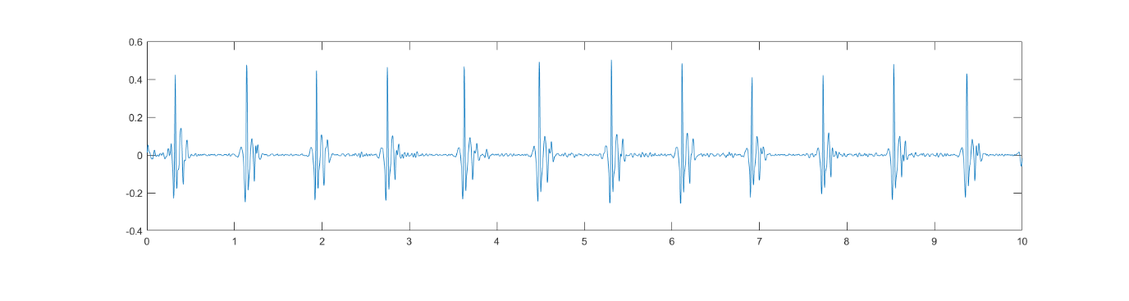
MODULE 1: PRE PROCESSING THE DATASET
Record 3 :
With baseline wandering:
Without Baseline wandering:

Slide 34
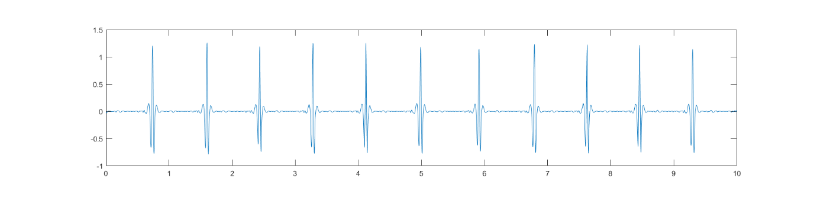
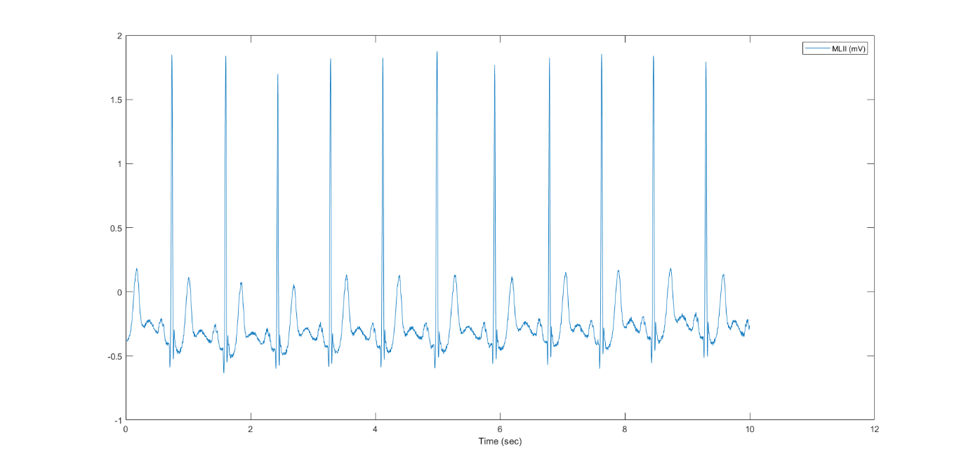
MODULE 1: PRE PROCESSING THE DATASET
Record 4 :
With baseline wandering:
Without Baseline wandering:

Slide 35
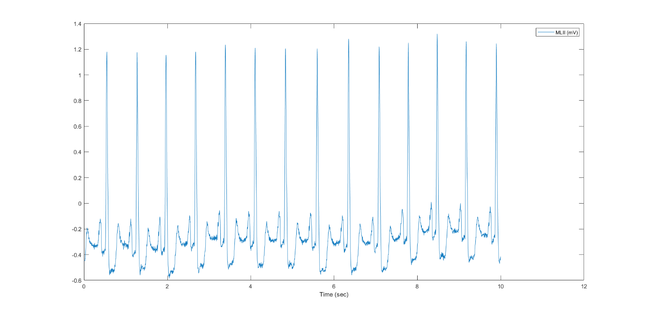
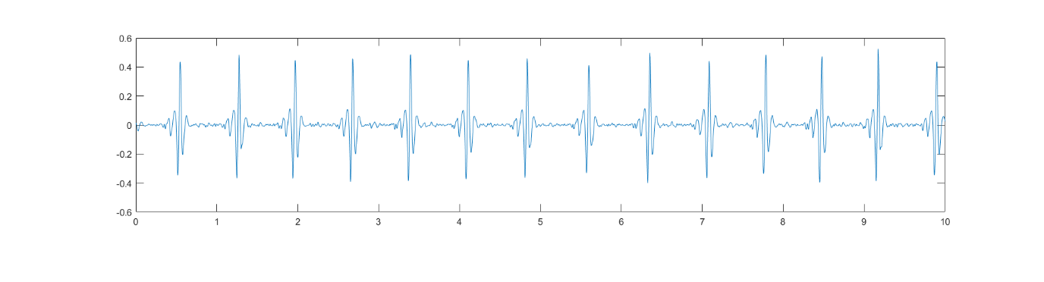
MODULE 1: PRE PROCESSING THE DATASET
Record 5:
With baseline wandering:
Without Baseline wandering:

Slide 36
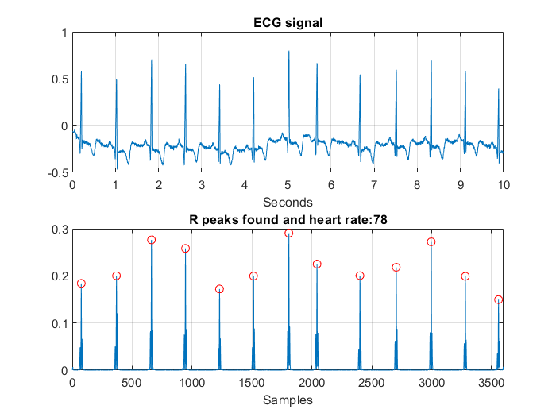
MODULE 2: - DETECTION OF R WAVES
1. Output for 4 records :
Record 100 :

Slide 37
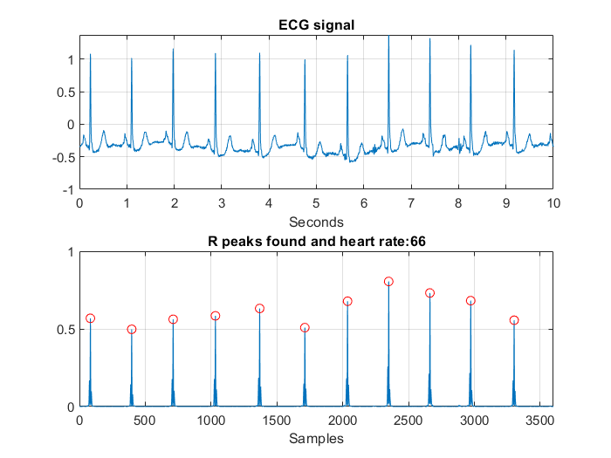
MODULE 2: - DETECTION OF R WAVES
2. Output for 4 records :
Record 101 :

Slide 38
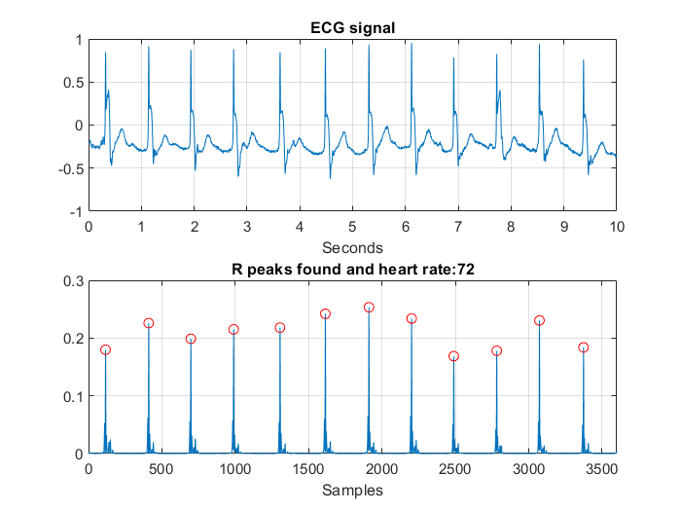
MODULE 2: - DETECTION OF R WAVES
3. Output for 4 records :
Record 102 :

Slide 39
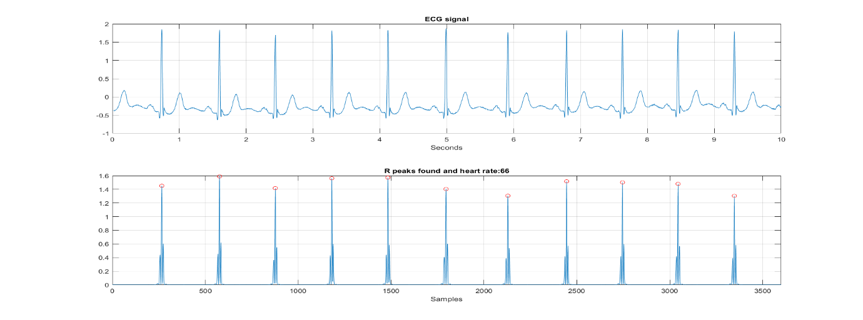
MODULE 2: - DETECTION OF R WAVES
4. Output for 4 records :
Record 103 :

Slide 40
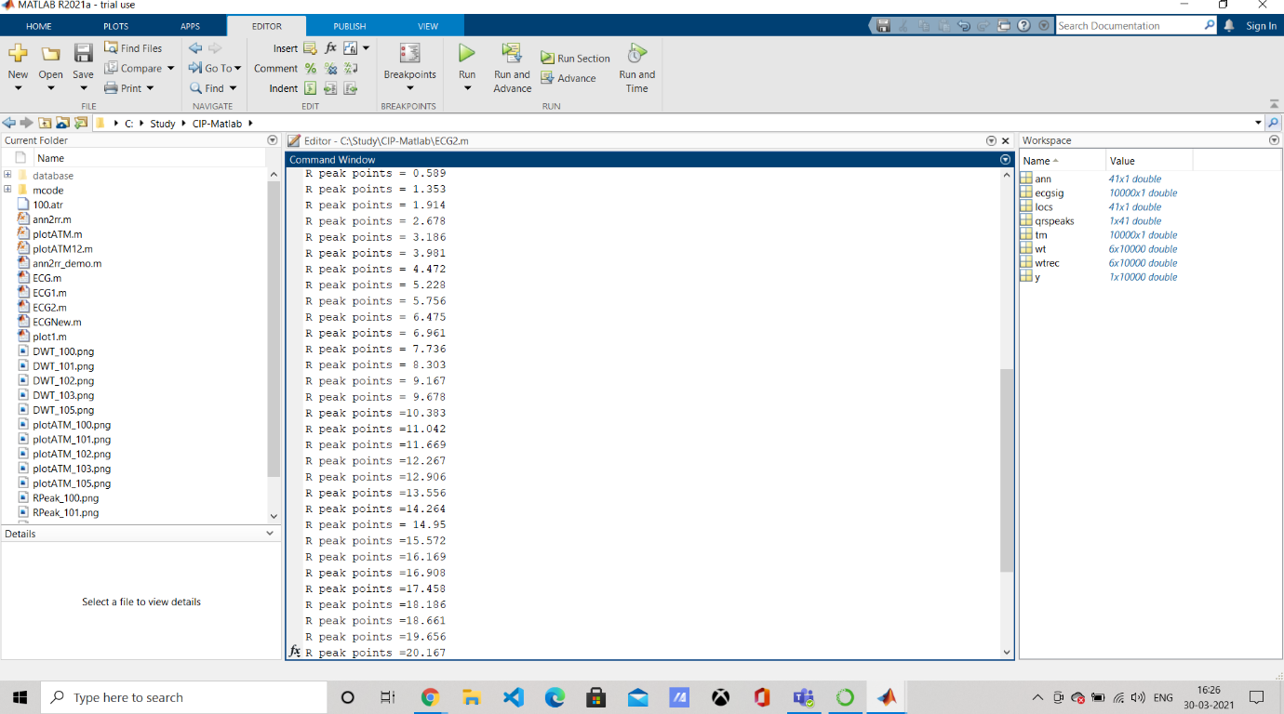
MODULE 2: - R PEAK POINTS
1. Record 200:

Slide 41
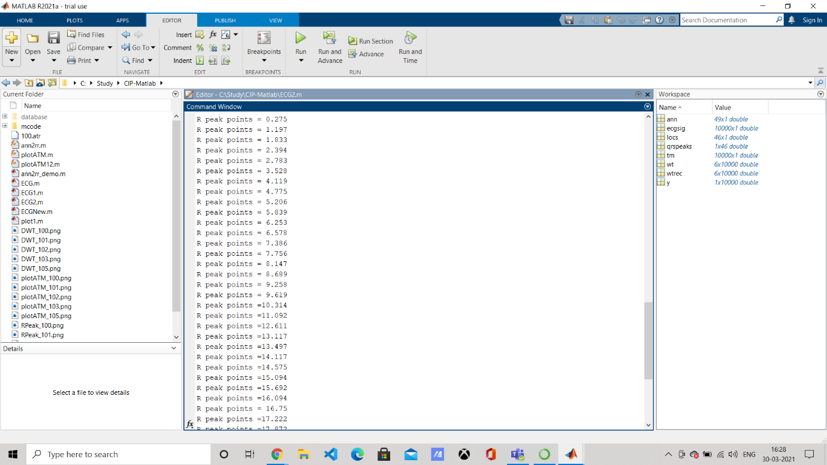
MODULE 2: - R PEAK POINTS
2. R peaks for record 203 in the dataset :

Slide 42
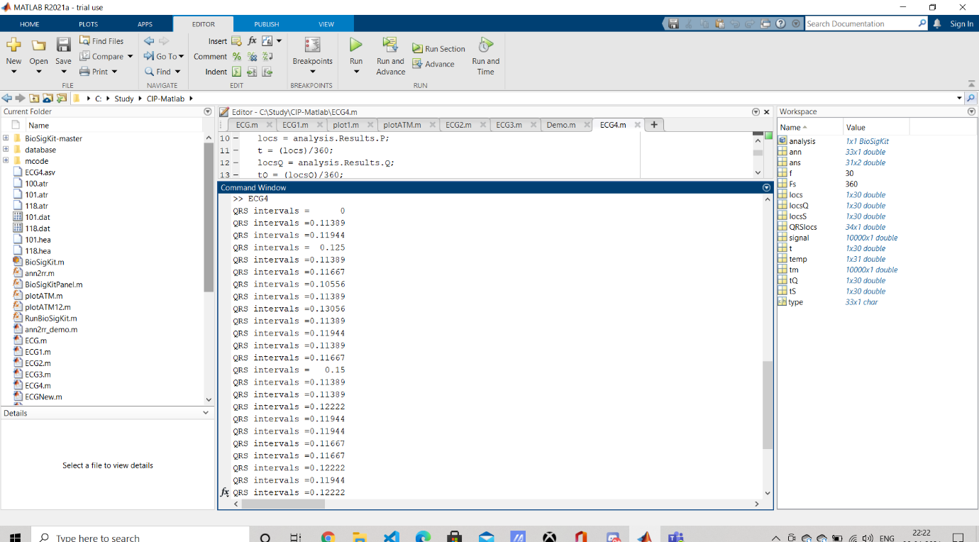
MODULE 3: DETECTION OF QRS COMPLEX
1. Record 101 :

Slide 43
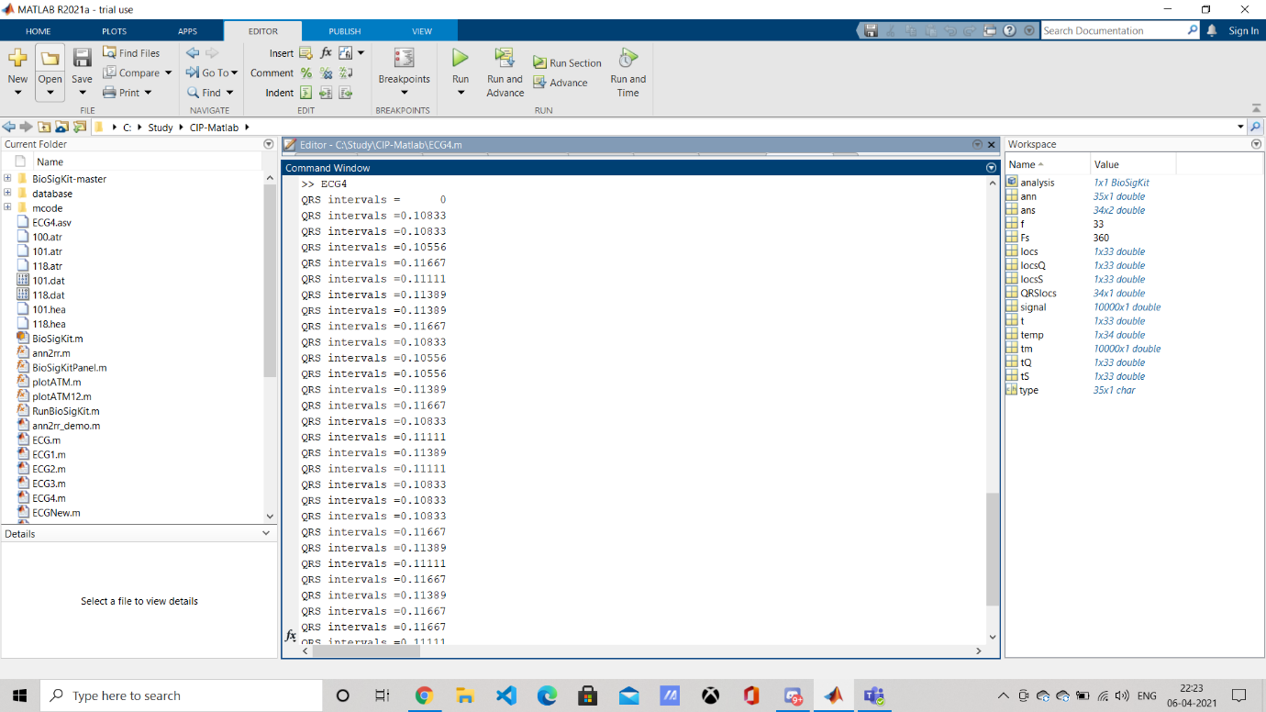
MODULE 3: DETECTION OF QRS COMPLEX
2. Record 118 :

Slide 44

MODULE 4: P WAVE DETECTION AND PR INTERVALS
1) Record 101 :

Slide 45
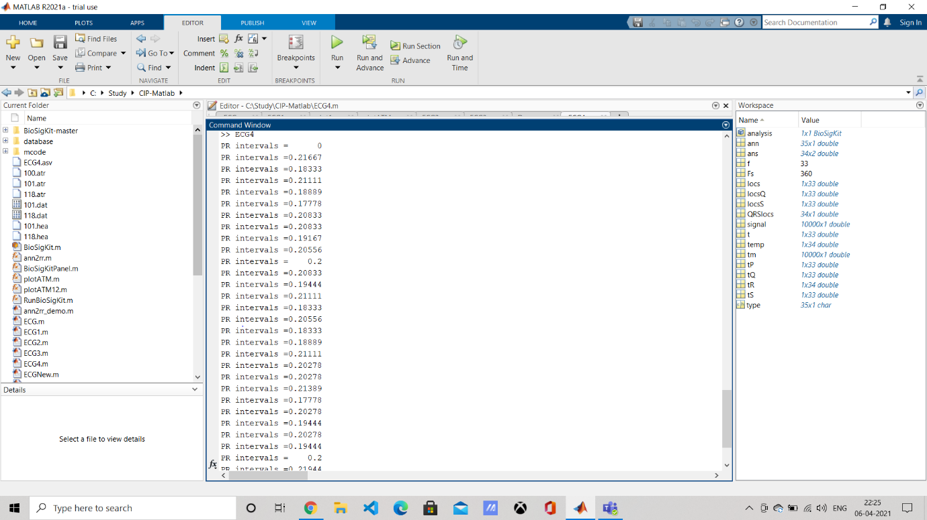
MODULE 4: P WAVE DETECTION AND PR INTERVALS
2) Record 118 :

Slide 46
Module 5 - Accuracy & Classification

Slide 47
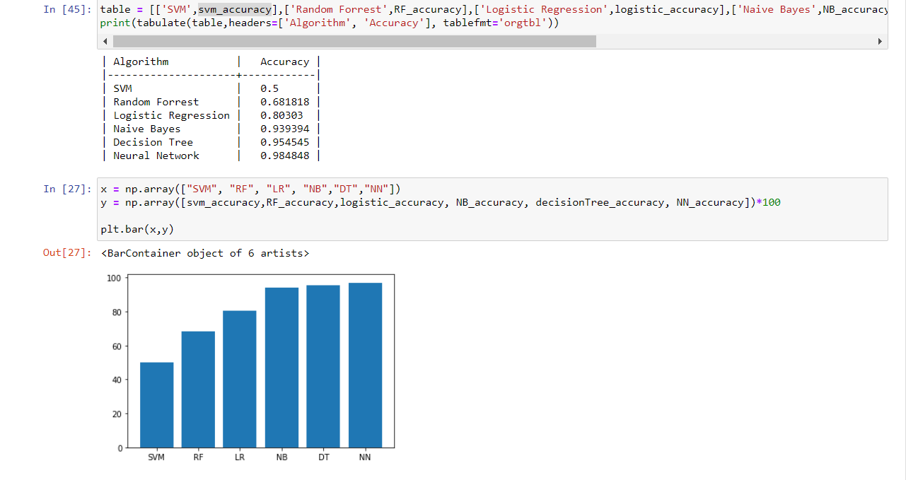
COMPARISON GRAPH

Slide 48
INNOVATION HANDLED
Baseline wandering has been removed and hence we can work with multiple datasets irrespective of the distribution that the data is from.
The features we have chosen (PR intervals, QRS complex,RR interval) performs very well on the input dataset.
The features when fed into a shallow neural network or into a decision tree classifier outperforms most of the pre-existing models.

Slide 49
CONCLUSION AND FUTURE DIRECTION
In the clinical routine, computer aided diagnosis of heart arrhythmias can reduce the workload of cardiologists.
As Machine Learning has evolved dramatically in recent years, it has reduced the workload of many things with the help of its algorithm.ms.
In this project, a proper understanding of different abnormal beats in an ECG recording is simplified and those beats are graphically represented using a graph.
The proposed System talks about different machine and deep learning algorithms which are used to measure the performance in terms of accuracy.
From the developed project we get an understanding that a Neural Network provides a better performance (accuracy) as compared to the other machine learning algorithms represented . With the recent state-of-the-art performances of deep learning, the biomedical scientists are coming one step closer to effective utilization of deep learning techniques to be carried out to assist clinicians and patients alike in the near future.

Slide 50
Future Work
With the model already being implemented, we can further extend this to working real-time with wearable devices.
This would decrease the already everpresent load on the laboratory industry and also reduce the costs of doing the tests.
Tachyarrhythmia which when occurs is fatal within an hour of its onset can be prevented using alert signals from these wearable devices.

Slide 51
REFERENCES
[1] A.S. Adabag, G. Peterson, F.S. Apple, J. Titus, R. King, R.V. Luepker, Etiology of sudden death in the community: results of anatomic, metabolic, and genetic evaluation, Am. Heart. J. 159 (January (1)) (2010) 33–39.
[2] J.J. Goldberger, A.E. Buxton, M. Cain, O. Costantini, D.V. Exner, B.P. Knight, D.Lloyd-Jones, A.H. Kadish, B. Lee, A. Moss, R. Myerburg, J. Olgin, R. Passman, D.Rosenbaum, W. Stevenson, W. Zareba, D.P. Zipes, Risk stratification for arrhythmic sudden cardiac death: identifying the roadblocks, Circulation 123(2011) 2423–2430.
[3] E. Asensio, R. Narváez, J. Dorantes, J. Oseguera, T.A. Orea, R.P. Hernández, G.V.Rebollar, L. Mont, J. Brugada, Conceptos actuales sobre la muerte súbita, Gac.Med. Mex. 141 (March–April (2)) (2005) 89–98.
[4] M. Velic, I. Padavic, S. Car, Computer aided ECG Analysis – State of the Art andUpcoming Challenges, 2013, arXiv:1306.5096v1 [cs.CV] 21 June.
[5] M.E. Guevara-Valdivia, Monitoreo a distancia de los dispositivos automáticos implantables cardiovasculares (marcapasos, desfibriladores automáticos implantables y resincronizadores cardiacos), Arch. Cardiol. Mex. 79(July–September (3)) (2009) 221–225.
[6] L. Gatzoulis, I. Iakovidis, Wearable and Portable eHealth Systems:Technological Issues and Opportunities for personalized care, IEEE Eng. Med.Biol. Mag. 26 (September-October (5)) (2007) 51–56
[7]Albert Haque, Cardiac Dysrhythmia Detection with GPU-Accelerated Neural Networks.
[8]Pranav Rajpurkar, Awni Y. Hannun,Masoumeh Haghpanahi, Codie Bourn, Andrew Y. Ng,Cardiologist-Level Arrhythmia Detection with Convolutional Neural Networks.

